Slide 1

The Franchise Database Management System
DONE BY
SRI CHARAN N SIVASAMY R M SHAMVRUTH K

Slide 2
PROBLEM STATEMENT
Managing sports franchise data, including teams and players, has traditionally been a cumbersome task using spreadsheets or paper- based systems. Existing methods suffer from issues such as data redundancy, errors during data entry, and difficulty in accessing and updating data. This results in inefficiency in managing large amounts of team and player statistics. The goal is to create a robust and efficient system to streamline data management for franchises, enabling quick access to up-to-date information while ensuring data consistency and accuracy.

Slide 3
OBJECTIVE
The main objective of this project is to design and implement a Franchise Database Management System (DBMS) using XAMPP and phpMyAdmin. This system will facilitate the management of franchise-related data by allowing users to:
Manage franchise, team, and player information
Perform CRUD (Create, Read, Update, Delete) operations efficiently Generate reports on player statistics and team performance Maintain data integrity and ensure secure access to franchise data.

Slide 4
ABSTRACT
The Franchise Database Management System aims to simplify and automate the process of managing sports franchises, teams, and players. This project uses XAMPP as the server environment and phpMyAdmin as the database management tool. The system provides a user-friendly interface to store, retrieve, and update player and team information. The DBMS will include features such as secure data management, real-time updates, and reporting mechanisms that help track and analyze player statistics and team performance.

Slide 5
EXISTING SYSTEM
Existing systems for managing franchise data typically rely on spreadsheets or rudimentary databases, which lack the functionality to handle large amounts of data efficiently. These systems struggle with maintaining data consistency, providing accurate reports, and ensuring easy accessibility of data. Additionally, manual updates increase the risk of human error, which can impact decision-making and performance evaluation.

Slide 6
PROPOSED SYSTEM
The proposed Franchise DBMS will be built on MySQL and will run on an XAMPP server. The system will provide a centralized platform for storing and managing team and player data, which can be easily queried and updated through an intuitive interface. Key features of the proposed system include:
Data Integrity: Ensures the consistency and reliability of franchise data.
Real-Time Updates: Allows for real- time changes to player statistics and team data.
01
02
Comprehensive Reports: Generates reports on player performance and team statistics, which can be used for analysis and decision-making.
03
04
Security Features: Protects sensitive data with user authentication and authorization.

Slide 7
ADVANTAGES OF PROPOSED SYSTEM
EFFICIENCY: Faster and more reliable data retrieval compared to spreadsheets.
SCALABILITY: Can handle growing amounts of data as more teams and players are added.
DATA INTEGRITY: Ensures data accuracy and consistency.
REAL-TIME REPORTING: Facilitates easy generation of reports on player performance and team metrics.
USER-FRIENDLY: Simple and intuitive interface for interacting with the database.

Slide 8
ARCHITECTURE DIAGRAM
The system follows a Client-Server architecture:
Frontend: The user interface, where users can interact with the system (could be phpMyAdmin or a custom interface).
Server (XAMPP): The local server running Apache and MySQL for backend processing.
Database: MySQL manages the storage, retrieval, and manipulation of franchise data.
The diagram should show the interaction between the User Interface, XAMPP Server, and MySQL database.

Slide 9
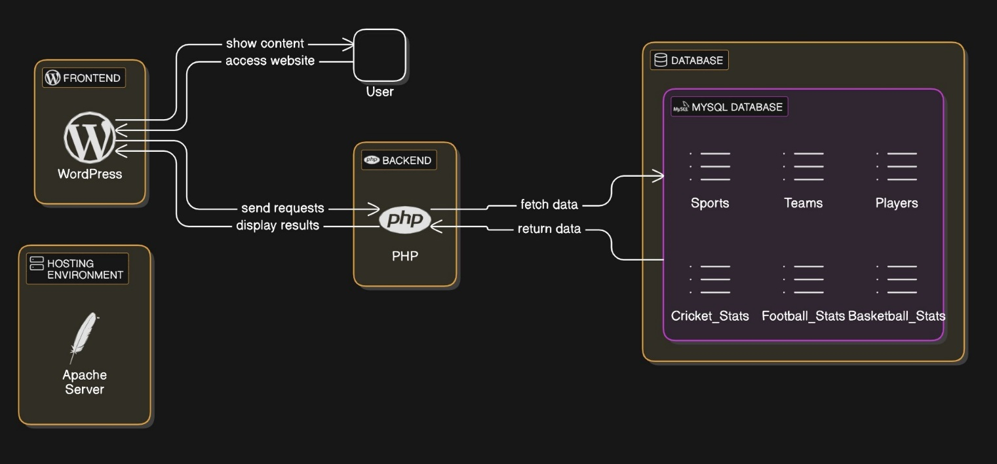
Fig: Architecture Diagram

Slide 10
MODULES WITH DESCRIPTION
Team Management Module: Allows the addition, modification, and deletion of teams, including relevant information such as team name, players, and team statistics.
Player Management Module: Manages player data, including their stats (e.g., goals, minutes played, passing accuracy) and updates player information.
Reporting Module: Generates detailed reports based on team and player statistics, including performance analysis.
Search and Query Module: Allows users to search for teams, players, and generate specific reports using custom queries.

Slide 11
SAMPLE OUTPUTS
Player Stats Query: Displays the stats for a selected player, including goals, minutes played, and passing accuracy.
Team Report: Lists all players in a team, showing their individual statistics (goals, assists, etc.).
Updated Player Data: A screenshot showing the modification of player stats after a successful update operation.

Slide 12
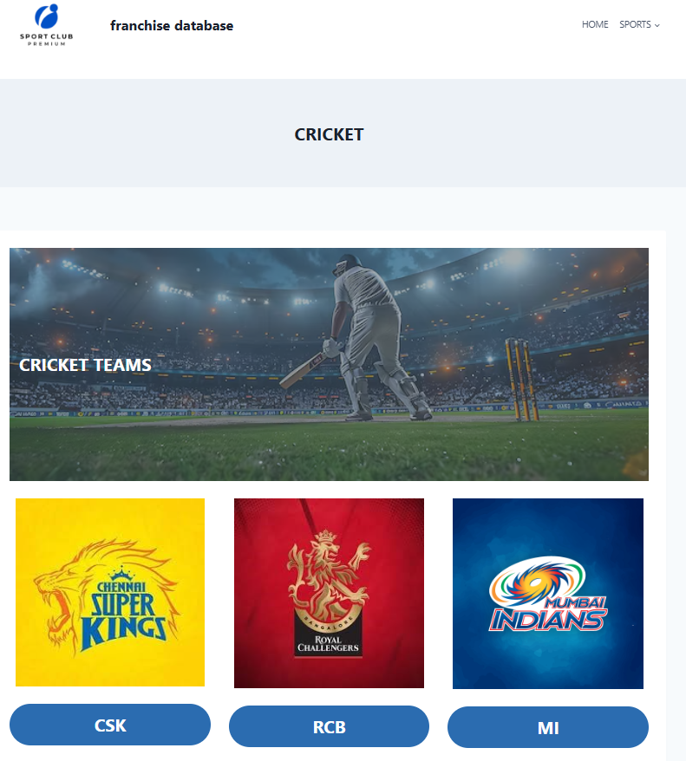

Fig: Choose Team
Fig : Choose Sport

Slide 13
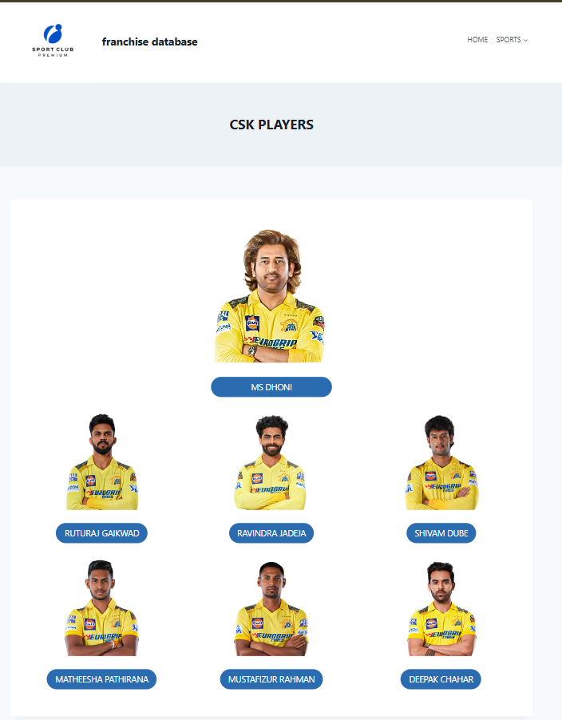
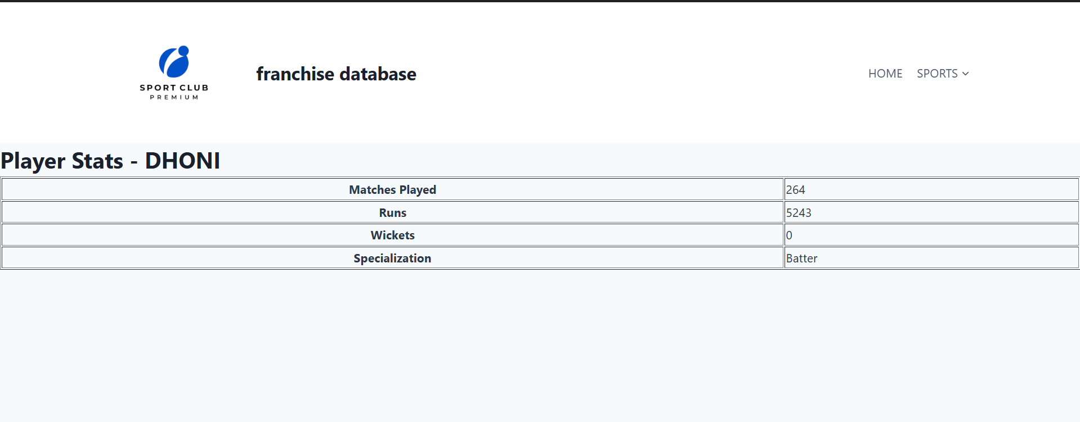
Fig: Player Details
Fig: Choose Player

Slide 14
CONCLUSION AND FUTURE WORK
The Franchise DBMS successfully streamlines the process of managing franchise, team, and player data. The system meets its objectives by ensuring data integrity, scalability, and easy reporting. In the future, the system can be expanded by:
Developing a web-based front-end interface for wider accessibility. Integrating additional features such as player injury reports or transfer history.
Enhancing security protocols to ensure the safety of user and
franchise data.
Expanding to support other sports and franchises.

Slide 15
REFERENCES
Websites:
phpMyAdmin Documentation XAMPP Official Website MySQL Documentation
Tutorials:
W3Schools MySQL Tutorial

Slide 16
KEY FEATURES
Centralized data storage for franchises, teams, and players.
User-friendly interface for managing and updating team/player data. Real-time querying and reporting tools.
Data validation and integrity checks to avoid errors. Secure access control and data protection.

Slide 17
TECHNOLOGIES USED (FRONTEND & BACKEND)
Frontend:
HTML, CSS, JavaScript (for future interface enhancements if applicable).
Backend:
PHP for server-side scripting and connecting to the database. MySQL as the relational database system for managing data.
XAMPP for running the Apache server and MySQL database locally.
Additional Tools:
phpMyAdmin for managing MySQL databases easily.

Slide 18

Thank You
DONE BY
SRI CHARAN N SIVASAMY R M SHAMVRUTH K

